Slide 1

NU - 302: Image Classification
Using Convolutional Neural Networks
Mentored by:
Dr. Prashant Srivastava
25.04.2019

Slide 2
Overview
Objective
Results of Completed Work
Future Work
Difficulties Faced

Slide 3
Objectives
To develop our concept of image classification from the ground-up, i.e, explore machine learning techniques first and then move onto deep learning techniques.
To research the underlying principles and techniques of image classification.
We also aim to, by the end compare the two most commonly used state-of-the-art techniques: CNN and SVM.

Slide 4
Review of Literature
A Survey on Image Classification Methods
A Survey on Image Classification approaches and techniques
Review of Image Classification methods and techniques
Review of Image Classification techniques

Slide 5
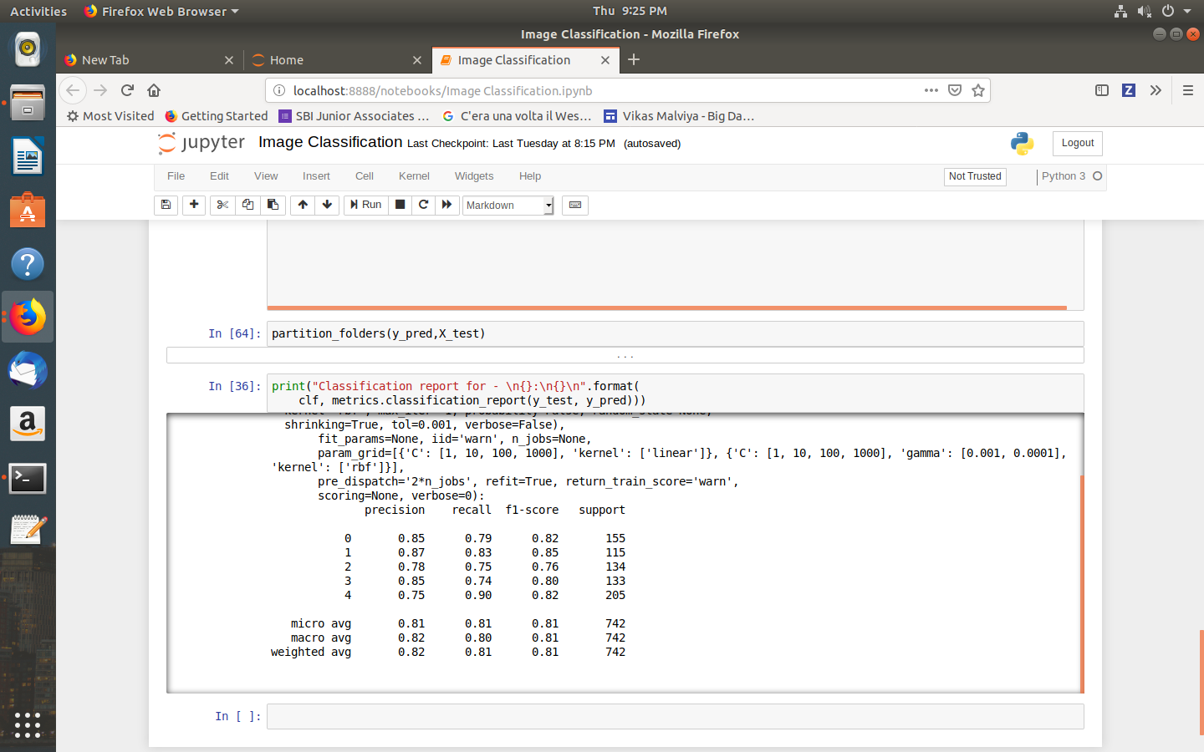
Work before Mid-Sem II Evaluation
Study of SVM
Implementation of Image Classification using SVM
Results of Implementation:

Slide 6
CNN

Slide 7
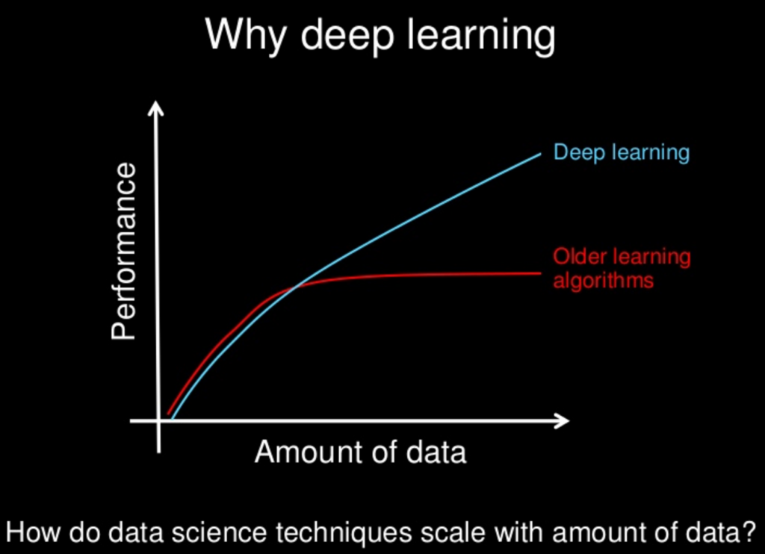
Why Shift to Convolutional Neural Networks?
Its potential for the model to learn useful features from raw data makes CNN capable of extracting informative features from images, eliminating the need of traditional manual image processing methods.
Notes:
This picture talks about the deep learning in general so it's better if we just mention it as one of the reason rather than making it a highlight.

Slide 8
CNN Architecture Used

Slide 9
5*5@6
5*5@16
max-pooling
IMAGE
S = 1
F=2, S = 2
S = 1
116*116*6
58*58*6
120*120*1
Data flatten
.
.
Max pooling
.
.
.
.
Soft-max
F=2, S = 2
FC
.
.
.
FC
54*54*16
27*27*16
5 output
classes
84 neurons
120 neurons

Slide 10
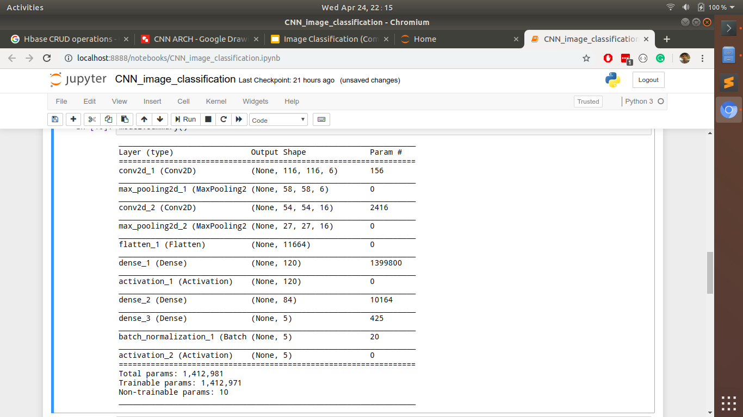

Slide 11
Max Pooling

Slide 12
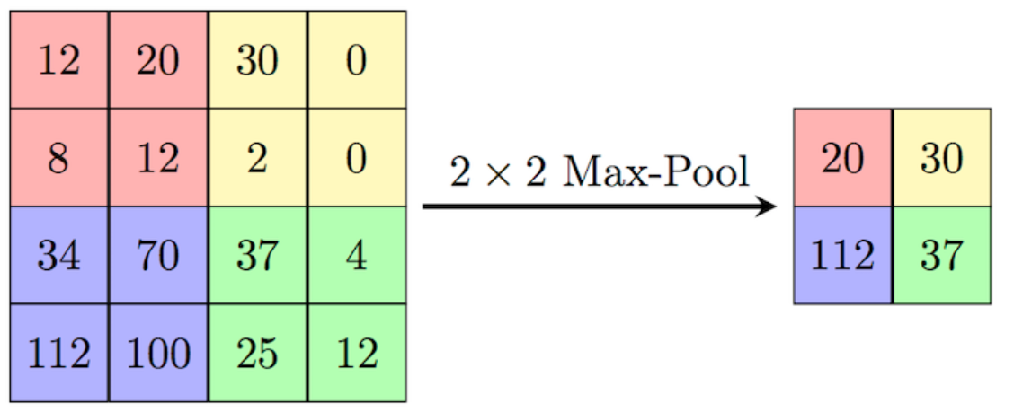
Considering the maximum value from each frame or window with predefined size in order to eliminate distortions

Slide 13
Advantages of Max Pooling
Max Pooling provides the Convolutional Neural Network with the “spatial Variance” capability.
Serves to minimize the images as well as the number of parameters which, in turn, prevents an issue of “overfitting” from coming up.

Slide 14
Softmax Activation Function

Slide 15
Softmax Activation and its purpose
Softmax activation is generally applied to the final layer in a multi classification problem
It is a nice way of assigning probabilities to every class and helps in predicting the outcome.
Ex:
5
2
-1
3
e^5
e^2
e^ (-1)
e^3
exponent
t(i)= ∑(t(i)/t)
0.842
0.042
0.002
0.114
1
0
0
0

Slide 16
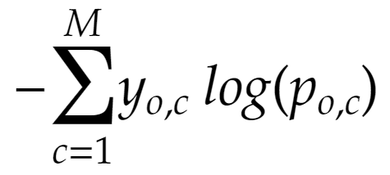
Loss Function (Log Loss)
Where y is either {0,1}, p is the probability assigned to that class and M is the no of classes present.
Ex: if a certain image is classified as dalmatian y₁ = 1 and the rest will be zero.
This loss function is minimized for every iteration.

Slide 17
Stochastic Gradient Descent

Slide 18
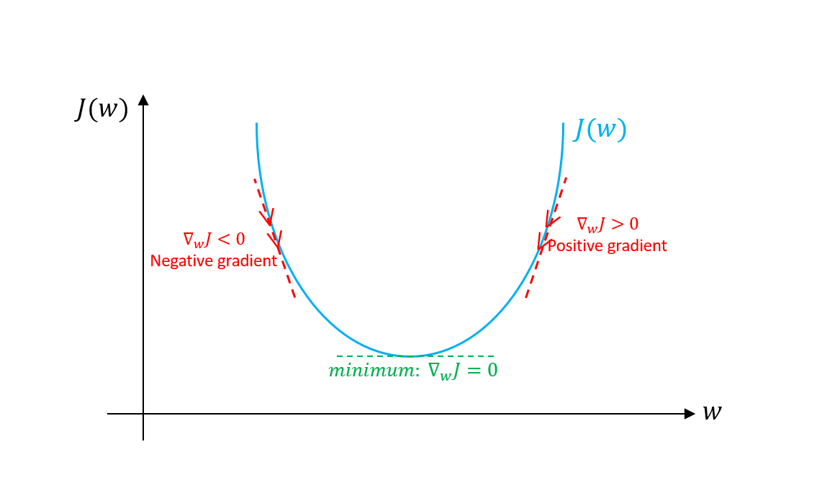
What is Gradient Descent?

Slide 19
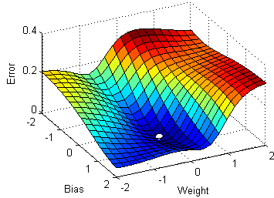
What is Stochastic Gradient Descent?
Thousands of data points to take into consideration each time
Solution: Stochastic Approach to Gradient Descent

Slide 20
Why Stochastic?
If computing loss takes n operations, then finding the gradient can take upto 3x the computational effort.
Computing the loss function takes into account every single data point. Since this process is iterative, we will go through the data point hundreds or thousands of times.
So instead, we pick a small number of random samples each time. This might seem counterintuitive at first but it actually ends up giving the right results, although requiring us to do it many times but saving up on actual data point considerations.

Slide 21
Data Augmentation
What is data Augmentation?
Why did we have to do Data Augmentation?
What all did we do in Data Augmentation?
Conversion from RGB color space to CMY color space
Dithering of an Image
Creating Primary colors version of an image
Translation of an image
Vertically Flipping an image
Horizontally Flipping an image

Slide 22
Results

Slide 23
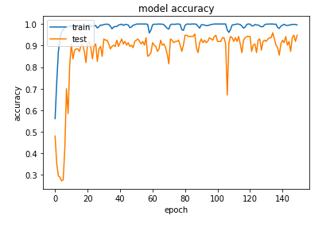
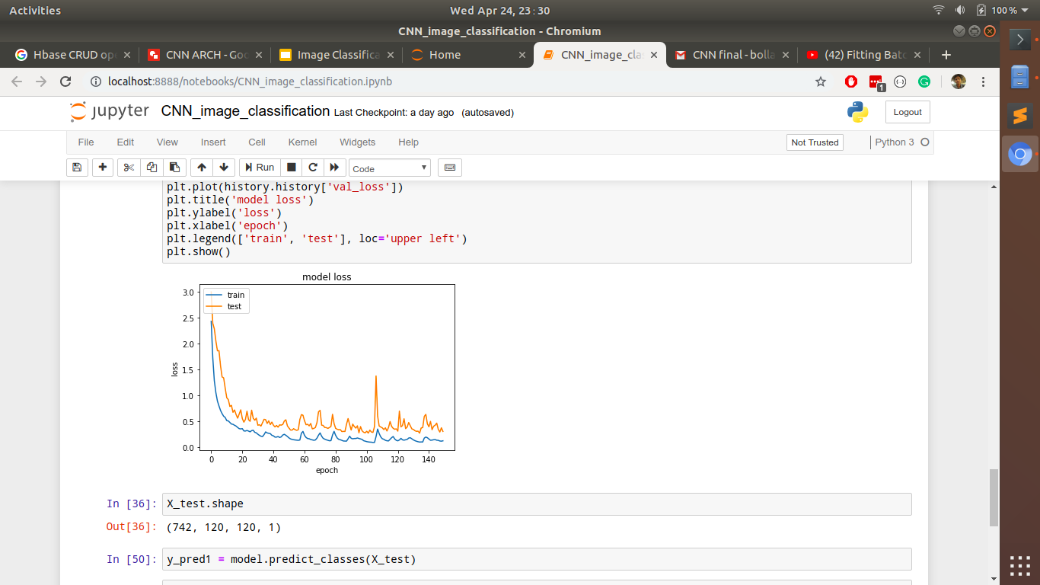
Variations in Accuracy and Loss for each value of Epoch

Slide 24
Confusion Matrix, Precision, Recall and F1-score
Predicted --->
……. | 0 | 1 | 2 | 3 | 4
0 | 130 | 0 | 12 | 3 | 6
1 | 0 | 125 | 3 | 1 | 3
2 | 1 | 0 | 199 | 1 | 6
3 | 3 | 0 | 16 | 233 | 2
4 | 4 | 0 | 8 | 1 | 182
………... | 0 | 1 | 2 | 3 | 4
Precision | 0.94 | 1 | 0.83 | 0.97 | 0.91
Recall | 0.86 | 0.94 | 0.96 | 0.91 | 0.93
F1-score | 0.89 | 0.97 | 0.89 | 0.94 | 0.92
Confusion matrix

Slide 25
Comparing results with SVM

Slide 26
References
https://www.analyticsvidhya.com/blog/2017/09/understaing-support-vector-machine-example-code/
https://medium.com/@tifa2up/image-classification-using-deep-neural-networks-a-beginner-friendly-approach-using-tensorflow-94b0a090ccd4
https://medium.com/@pechyonkin/key-deep-learning-architectures-lenet-5-6fc3c59e6f4

Slide 27
References
Kurian J. and Karunakaran V. (2012). A Survey on Image Classification Methods. [online] Pdfs.semanticscholar.org. Available at: https://pdfs.semanticscholar.org/8fcc/28ca0cd491c62868ee8866784ee6cf40f374.pdf [Accessed 7 Feb. 2019].
Kamavisdar P., Saluja S. and Agrawal S. (2013). A Survey on Image Classification approaches and techniques. [online] Pdfs.semanticscholar.org. Available at: https://pdfs.semanticscholar.org/9509/c435260fce9dbceaf44b52791ac8fc5343bf.pdf [Accessed 7 Feb. 2019].
Nupur Thakur, Deepa Maheshwari. A REVIEW OF IMAGE CLASSIFICATION TECHNIQUES. Available at: https://www.irjet.net/archives/V4/i11/IRJET-V4I11287.pdf
Maneela Jain, Pushpendra Singh Tomar. Review of Image Classification Methods and Techniques. Available at: https://www.ijert.org/research/review-of-image-classification-methods-and-techniques-IJERTV2IS80157.pdf

Slide 28
Thank You

